Slide 1

Welcome to Altrusa District Two
TREASURERS WORKSHOP
Presented by Anneke Fleming
District Two Treasurer
March 23, 2026

Slide 2

What we will be discussing:
TREASURER
WORKSHOP
AGENDA
Treasurer’s Calendar
General Responsibilities
Group Tally
Financial Responsibilities
Cyber Fraud
Resources

Slide 3

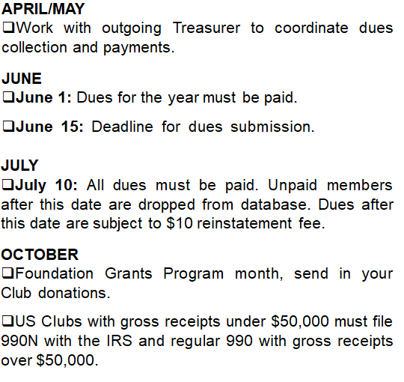
Treasurers Calendar
DECEMBER
December 1: International Half-Year (half-price) dues go into effect for new members and remain in effect until March 31 to encourage new members to join.
MARCH
March 31: is the last day for International Half-Year Dues.
Half-Year Dues are applied to the current year’s membership. New members will be billed the full dues amount for the following year.
APRIL
New members paying dues between April 1 and May 31 receive full membership for the remainder of the fiscal year and the following year.
Send contribution to Foundation.
Work with incoming Treasurer.
This is in the TREASURERS GUIDE on the International Website

Slide 4

General Responsibilities
MEMBERSHIP RECORDS
Maintain accurate Club membership records including information on each member’s payment status, ID Number, email address, telephone number and primary address, in Group Tally and with the District Treasurer.
Update Club membership changes (including new members, dropped members or deceased members) monthly in Group Tally and with the District Treasurer.
Review club records on Group Tally prior to annual dues and make updates.

Slide 5
MEMBER MANAGEMENT
Group Tally Manuals and Videos Tutorials
To sign into the Group Tally platform for the first time, your email address must be in the system. Once you have obtained the Full Administrative rights, from your Club President or previous Treasurer, sign into Group Tally.
For more detailed instructions see the Group Tally instructional PDF guides and tutorials. To find these tutorials you must Sign in to the Altrusa International Website and select the “Leadership tab”, scroll to “Club Treasurer” and “Group Tally Manuals and Videos Tutorials”. After selecting “Group Tally Manuals and Videos Tutorials” you will see the PDF Guides for using Group Tally.

Slide 6
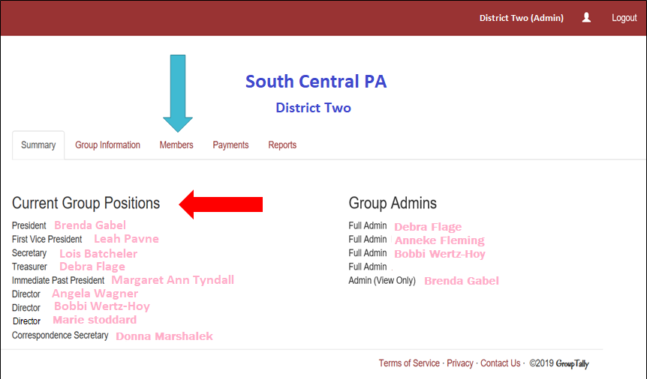
Logged in to your Club Page, will be your “Club Name” and “Current Group Positions” reflecting your club’s officers. Click on Members.
Club Officers
Positions

Slide 7
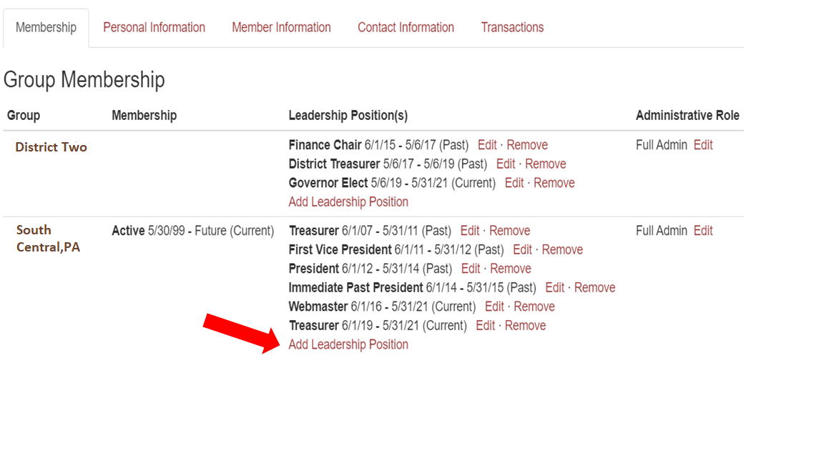
Click the name from the Group Positions list or by searching the name, click on it, and the member’s page will come up. Here you find information on what District and Club the member is a part of, as well as the dates and any leadership positions assigned to them, past and present. Click on the Add Leadership Position link.

Slide 8
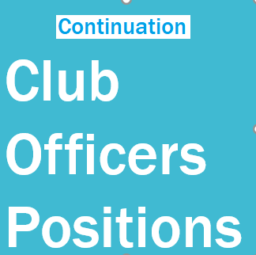
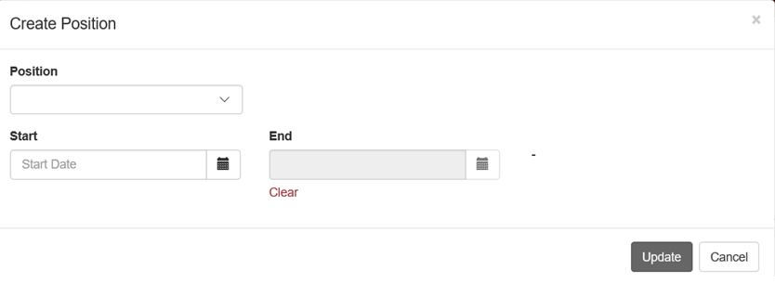
Click the Position drop box to select a position, and then enter the dates the member will hold that position.
THE DIALOGUE BOX WILL APPEAR
Once you click on Update, your newly assigned position will appear under the Leadership Position(s) heading. If it does not appear instantly, please refresh the page or log out and log back in, please do not repeat the process multiple times.

Slide 9
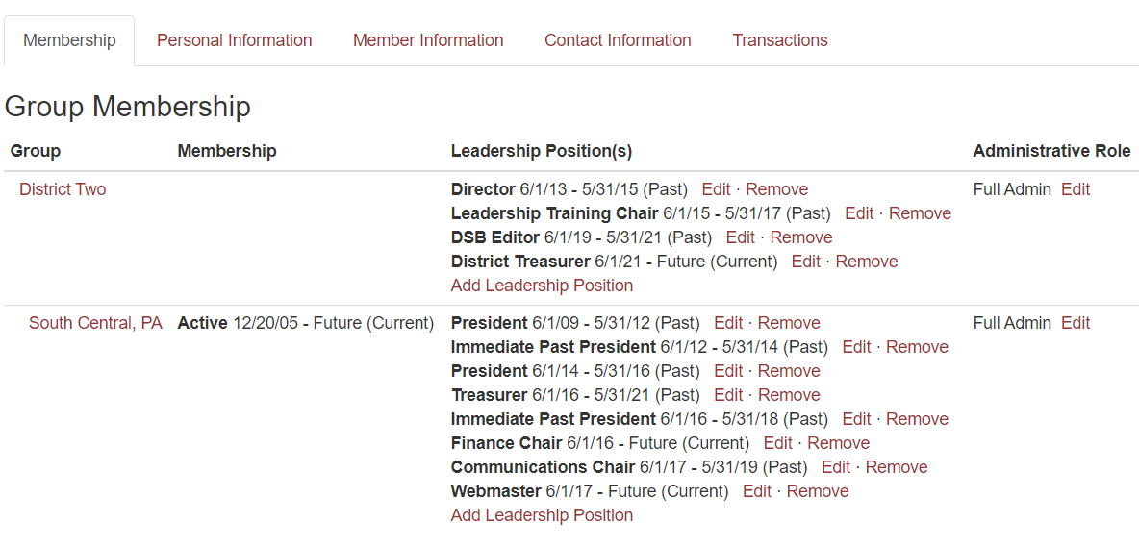
USE THE “EDIT” LINK TO ADJUST ROLES THAT ALREADY EXIST.
If member’s term has no end date, or needs to be adjusted,
use the edit feature instead of removing a position.
We would like past roles to remain listed so there is a record of positions each member has held.

Slide 10
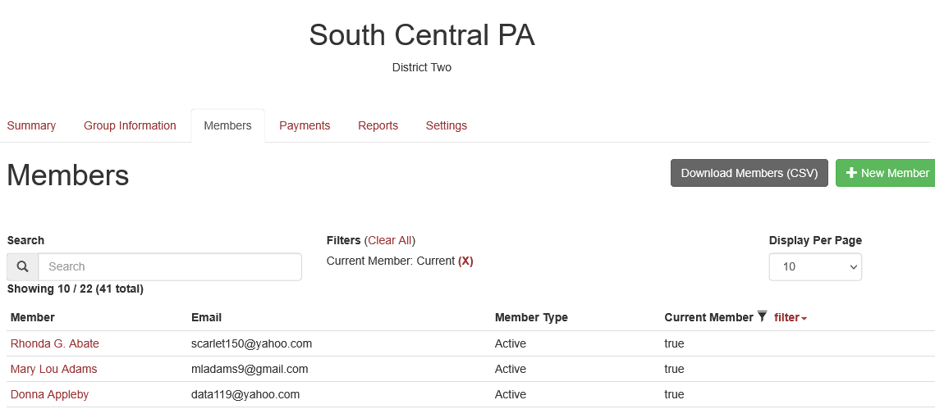
From Members page you can ADD a New Member
click on +New Member
Updating
Members

Slide 11
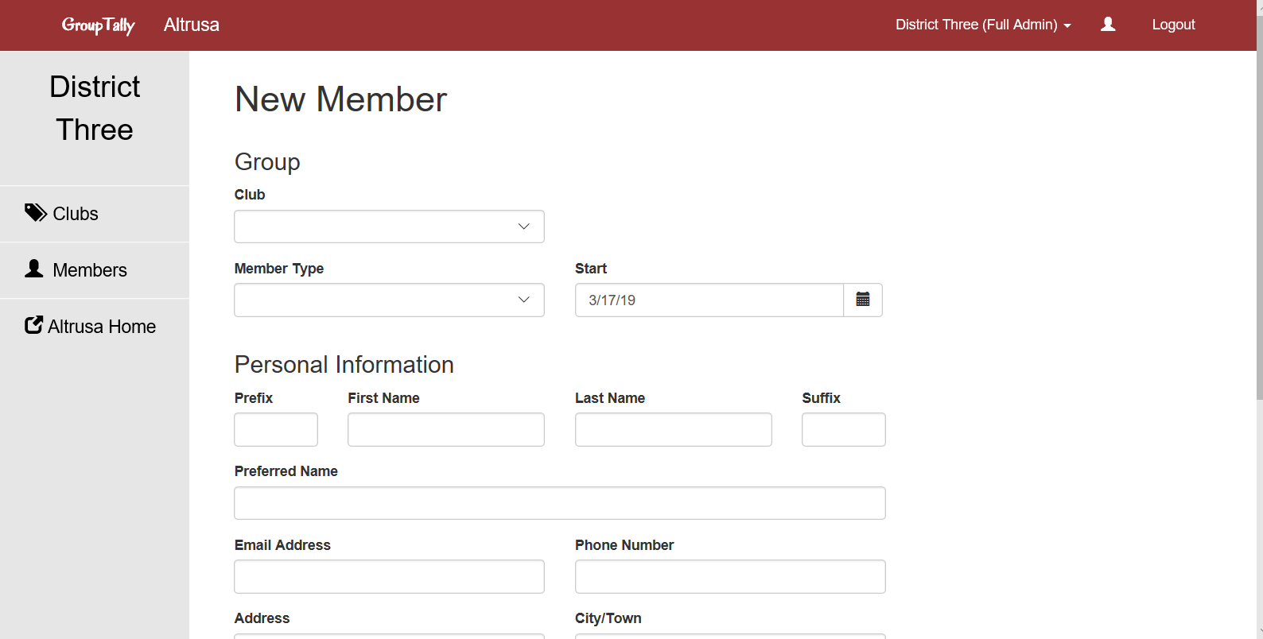
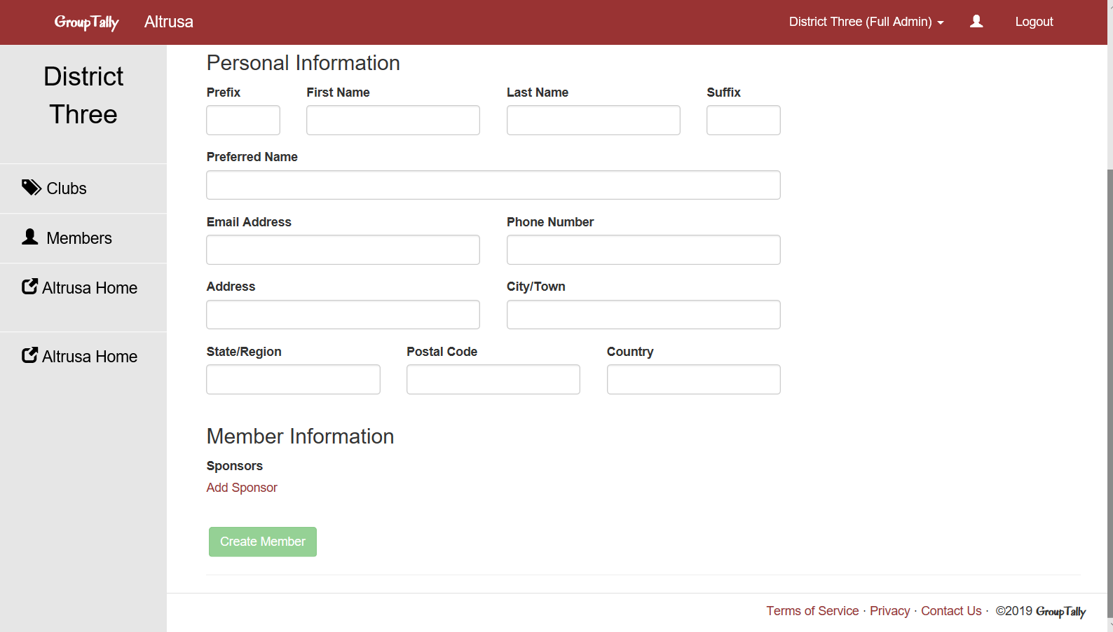
Simply fill
in the form…
Apply your club name
The drop-down choices for
Member Type are Active and
Affiliate
Please don’t forget to click
on Add Sponsor and input name
Finish by clicking
Create Member

Slide 12
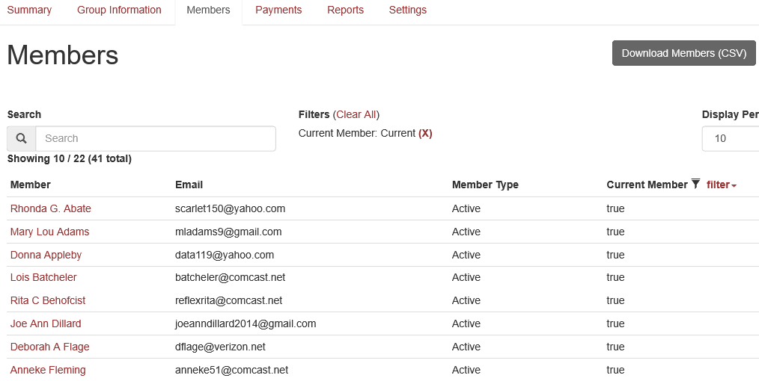
Locate existing members to edit by Search bar
or clicking on their Name on the Members page

Slide 13
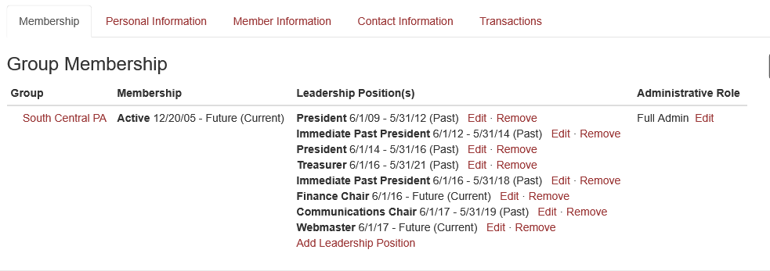
From the members page you can update
Personal Information, Member Information, Contact Information and see Transactions
of Dues and Fees, click Edit.

Slide 14
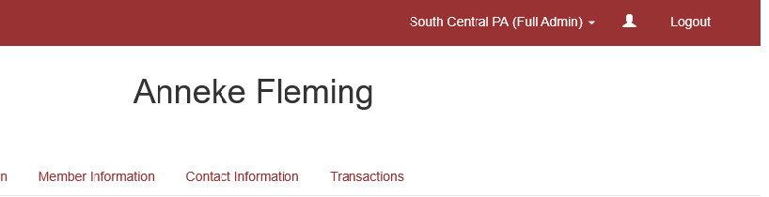
Payment
Methods
These are the ways to make a payment
Link your bank account and transfer funds directly or link a credit card.
Link account or credit card, first as Club Treasurer go to YOUR member page, click silhouette in upper right corner of red bar.

Slide 15
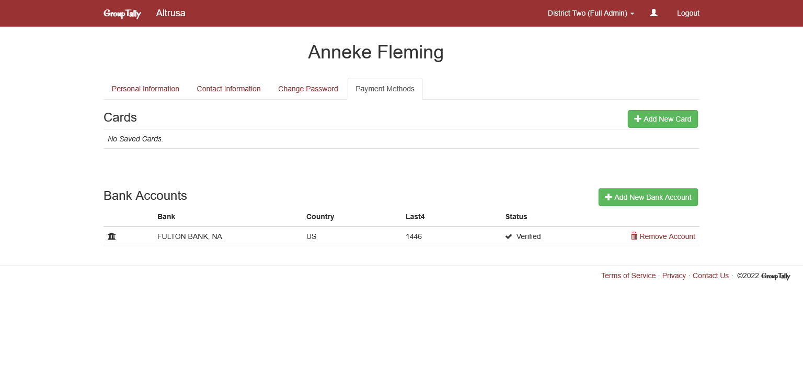
You will see a page with your name at the top,
and a few tabs will be available. Choose Payment Methods tab.
Then click “Add New Card” or “Add New Bank Account”

Slide 16
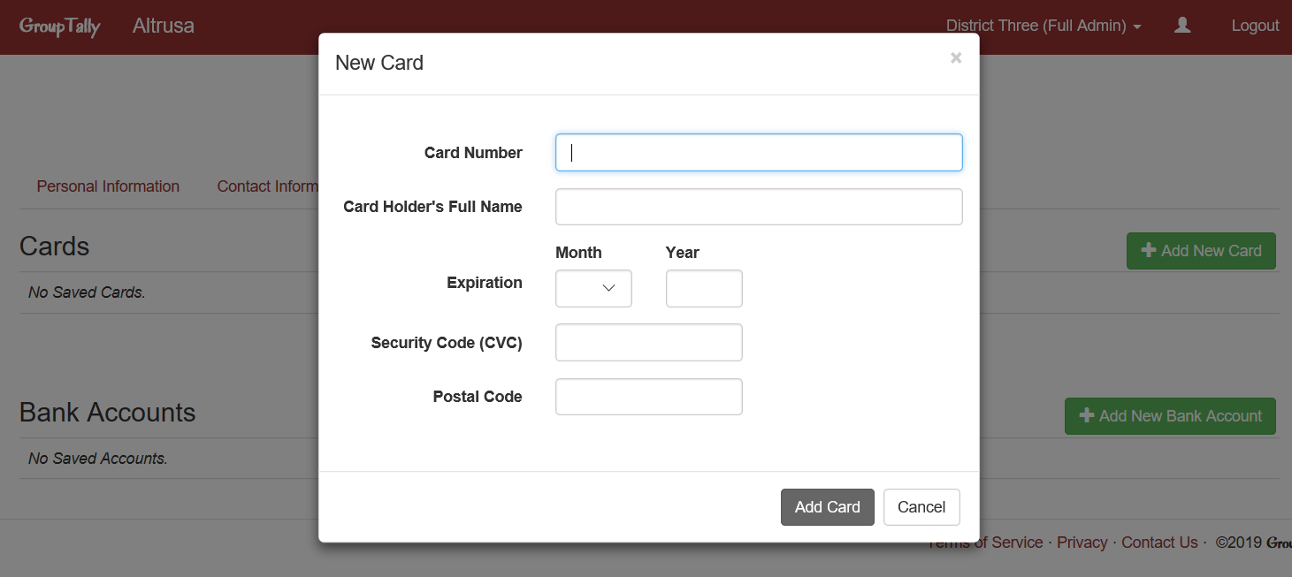
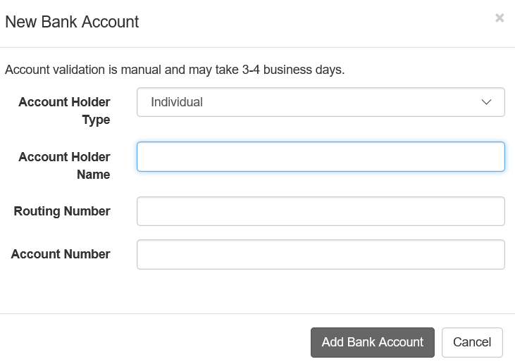
On this page, you see payment methods previously entered, or it may be blank. To link a credit card, click on Add Card or Add Bank Account to link a bank account. If paying by check skip this step. For each option, a dialogue box will appear for you to fill out.

Slide 17
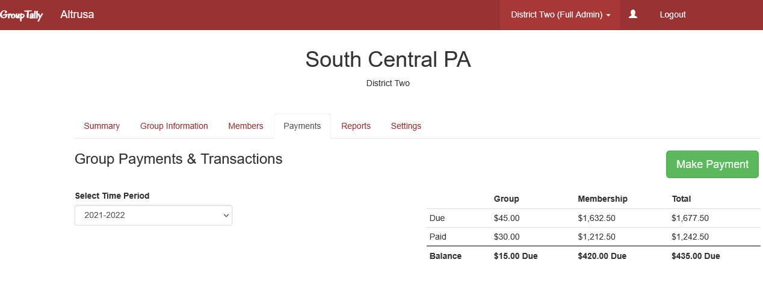
Making a Payment
The Payments page is divided into four sections.
Group Payments, Payments, Group Transactions, and Member Transactions.
If you have a balance, the Make Payment button will be available to you. No Balance No Button.
If Balance Due CLICK
Payment button

Slide 18
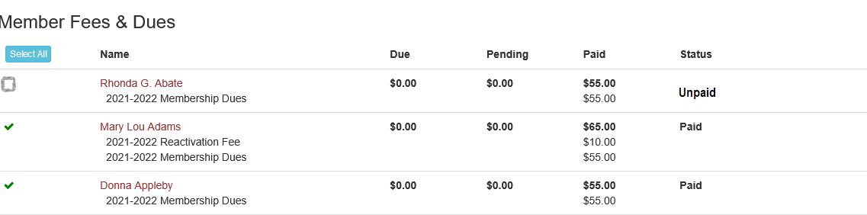
On payments page you will find a list of dues, those with green check marks have been paid, and open check boxes are unpaid and available for selection.
On payments page you will find a list of dues, those with green check marks have been paid, and open check boxes are unpaid and available for selection.

Slide 19
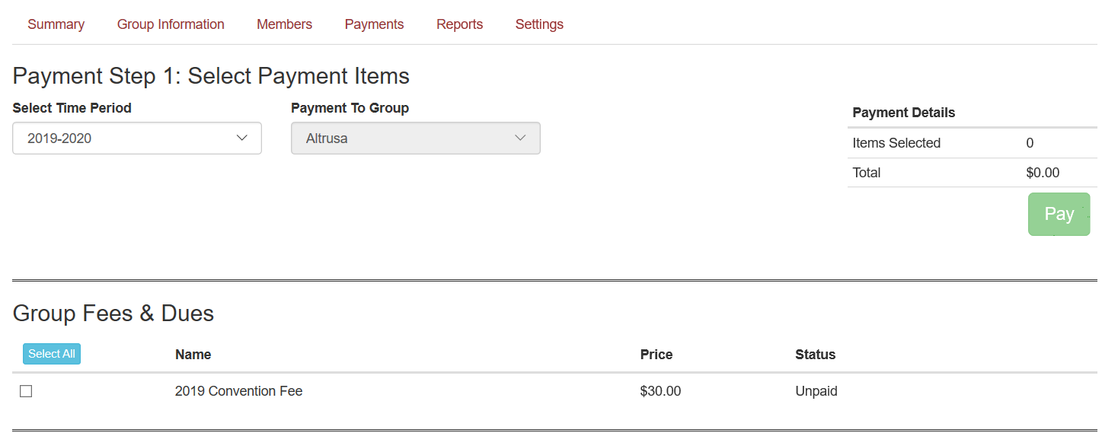

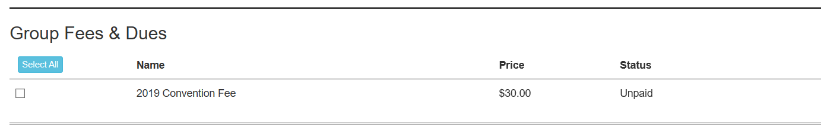
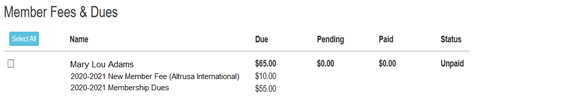
Select
Members
and
Items to
Pay
When Selection is made click Pay Button

Slide 20
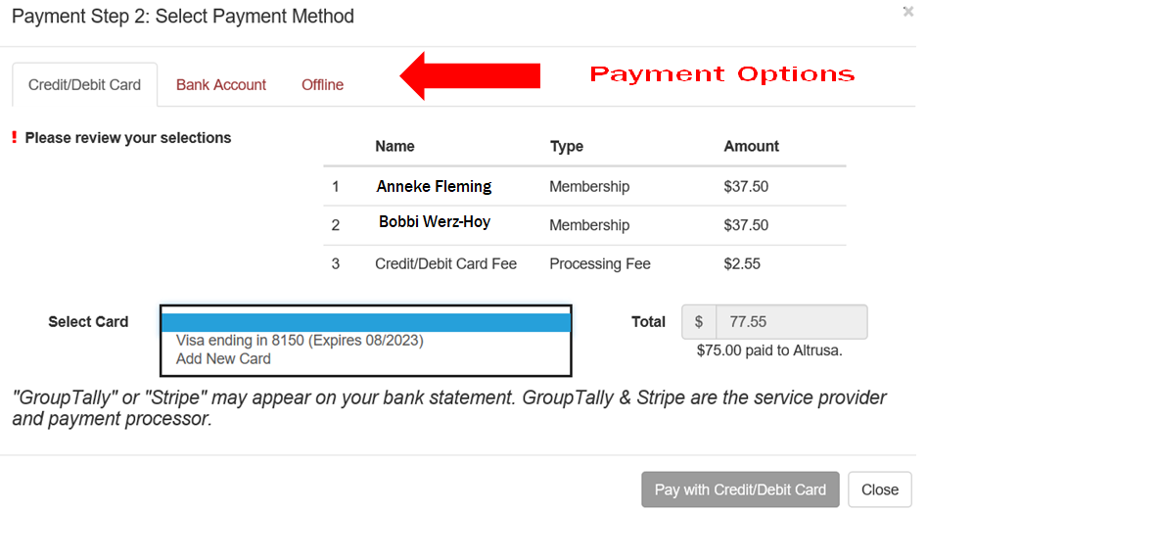
Once you click pay button, select Credit/Debit Card or Bank Account .
Here I have chosen Credit Card so I click on “Pay with Card”

Slide 21

Financial Responsibility
Financial Duties
Plan annual budgets.
Receive, record and deposit funds in approved Club accounts and maintain records of those accounts.
Pay all Club bills and dues that have been AUTHORIZED by the Board in a timely manner.
B. Dues and Fees
Familiarize yourself with International and District financial policies and procedures.
Collect and submit dues to International and District in accordance with deadlines. All must be Postmarked by June 15.

Slide 22

Financial Responsibility
C. Financial Reports and Records
Report on financial matters at each business meeting, Club Board, Club’s annual meeting and on request.
Submit annual report and Club financial records for audit
D. Members on “Leave of Absence”
Sometimes members are not able to regularly attend meetings. Events in their lives change and their schedules can get overwhelming. Granting a leave of absence is a matter between the member and the Club. Members on leave must still pay their dues to remain Active members.

Slide 23

A.
Financial
Duties
Plan Annual Budgets
Our Fiscal year is June 1st – May 31st
Develop budget with Finance Committee, approved by Club Board,
presented to club once approved. Ideally all before March 1st. The
general operating budget is based both on anticipated income from
dues and membership processing fees and on estimated fundraising
and donor income.
The general operating budget must provide for the following operating expenses:
International Dues
Membership processing
District Dues
International Convention Fees
Club Officer/Committee expenses
Fixed Operating Expenses (PO Box Rental, Web Site Hosting, etc.)
General office supplies and postage
Delegates expenses for District Conferences
Delegates expenses for International Convention
A SAMPLE BUDGET is shown in the Treasurers Guide

Slide 24
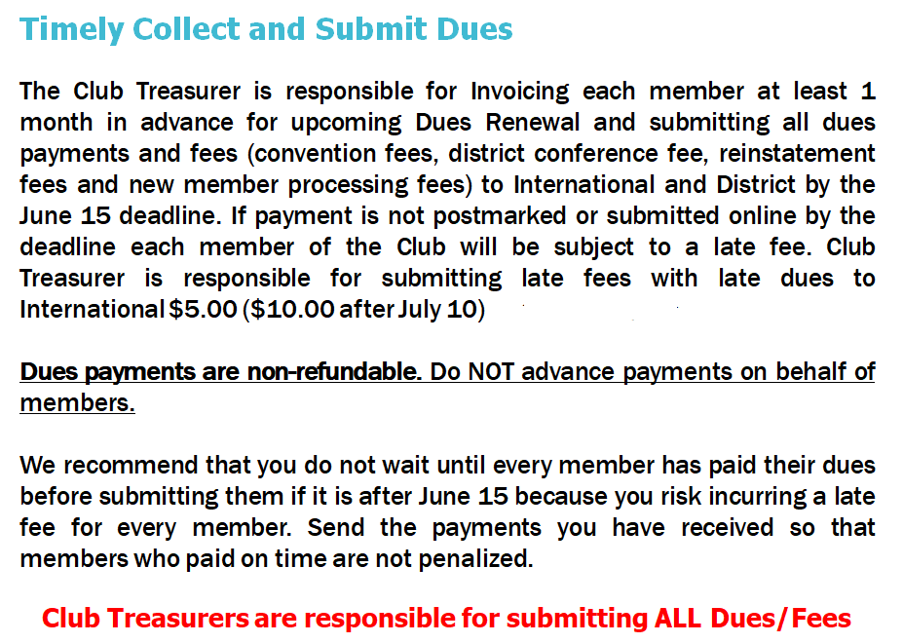

B.
Dues
and Fees

Slide 25

C.
Financial
Reports
PROVIDE REGULAR MONTHLY REPORTS
Each month reconcile your checking account and generate monthly reports. Report Income and Expenses, include budget status at each business meeting. We recommend QuickBooks. Your reports are easy to compile.
You should provide:
Balance Sheet – Statement of Financial Position
Profit & Loss Budget vs Actual
Profit & Loss Previous Years Comparison (Year to Date)
Monthly Accounts Receivable
Monthly Accounts Payable
Monthly Membership Totals
At end of the year submit an annual report and all Club financial records for club Finance Committee Audit/Review.

Slide 26

75 Million Scam Emails Are Sent Every Day!

Slide 27

CYBER FRAUD
Please be AWARE of the existence of cyber fraud
Be careful when making payments and vigilant regarding not only AUTHORIZING payment but ensuring the RECIPIENT’s Identity. We have had incidents where District Treasurers were asked to make a payment by an email from their Governor. It will appear to be the Governor’s email address but will be slightly different. Do NOT respond or click on any “links”. We recommend you call your Governor to verify payment.
We are concerned that this fraudulent activity could impact Club Treasurers. Please ensure you do not provide financial information or passwords to anyone via email, as email accounts can be hacked. If unsure about a payment request, we suggest you pick up the phone and talk directly with your Club President. Remember if it seems strange, do some extra verification!

Slide 28

CYBER FRAUD
To protect yourself, we urge you to:
Periodically change your passwords and use two factor
authentication whenever possible
Monitor online banking – report suspicious activity
Monitor email accounts – if any unusual activity, update
anti-virus software
Be wary of international phone calls of unknown origin
Be wary of clicking on links and attachments from senders
you do not recognize and even some you do
Do not wire or send funds without authenticated authorization !!

Slide 29


Resources
Information on all materials, merchandise (thru Doc Morgan, which is Altrusa’s official supplier), IRS Filing, Treasurers Calendar, Dues and Fee Schedules, Group Tally Guides and Videos, any and all contact information for District and International can be found online and requires password-protected login.
Altrusa International Website: altrusa.org
Altrusa District Two Website: districttwo.altrusa.org
District Two Treasurer: districttwotreasurer@gmail.com
IRS Filings if needed
990-N Filing Info: irs.gov/instructions/i990

Slide 30

FOR YOUR SERVICE TO ALTRUSA

