Slide 1
Membership Dues Information Session

Slide 2
District Two Official Bylaws Article XV. Dues and Fees Each Club shall transmit to the District Treasurer the dues as established by the District Board of Directors for each of its Active members. Each Affiliate member will transmit to the District Treasurer District dues as established by the District Board of Directors.
In a special session of the District Two Board on January 29, 2024, the board voted unanimously to raise the District membership dues from the current annual amount of $20 per member, to $30 per member, effective June 1, 2024.

Slide 3
Historical Information Increased inflation, decreased membership
Dues have not been raised since at least 1996
Inflation from 1996 to 2023 has increased 97%
What cost $1.00 in 1996 costs $1.97 now
Since 2012, District Membership has decreased by 34% (2012: 389, 2023: 258)
We have also lost entire clubs (disbanded)

Slide 4
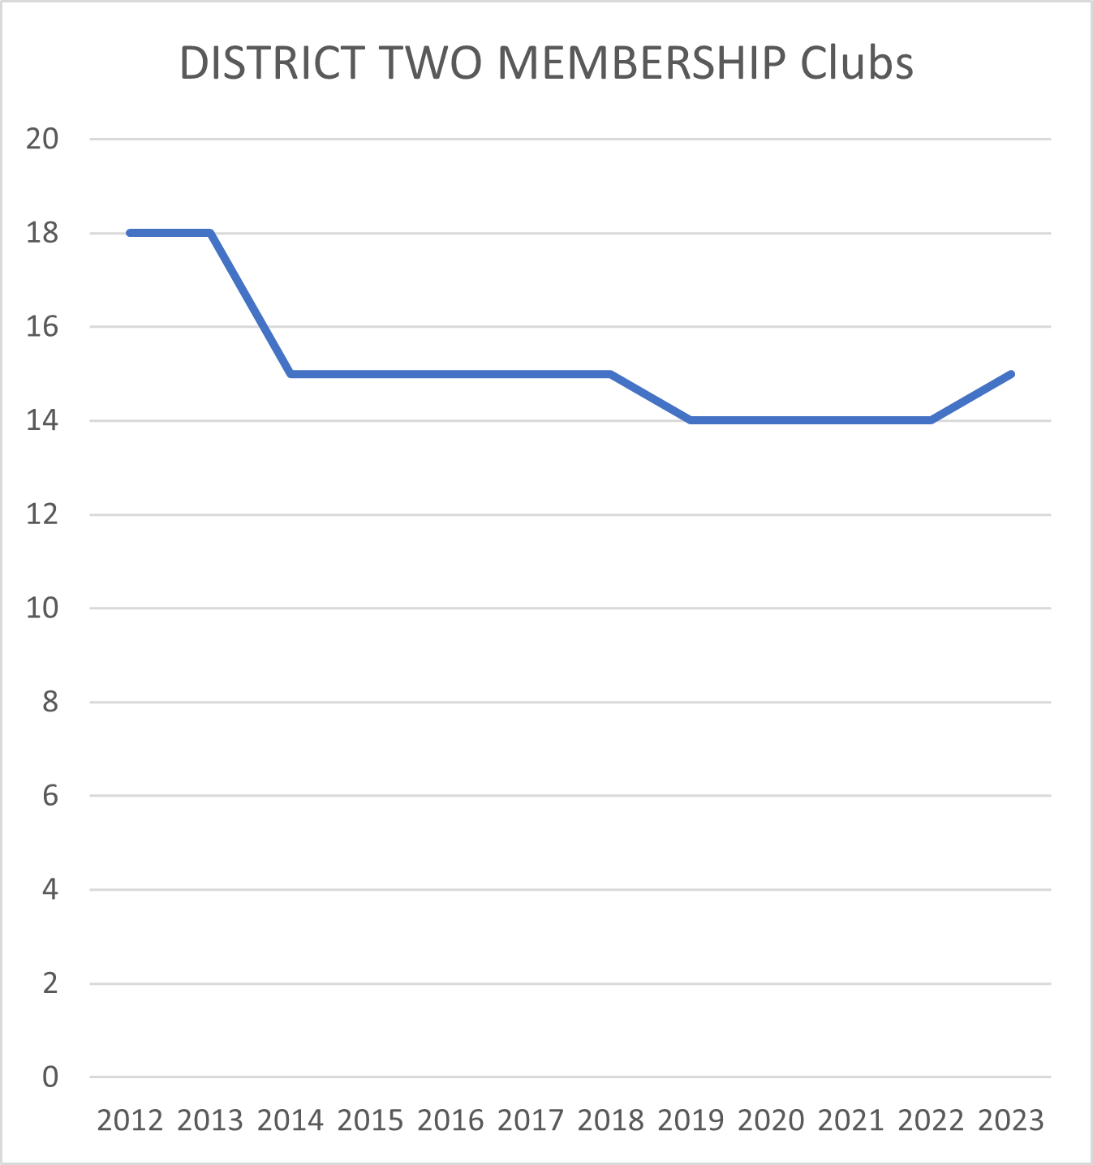
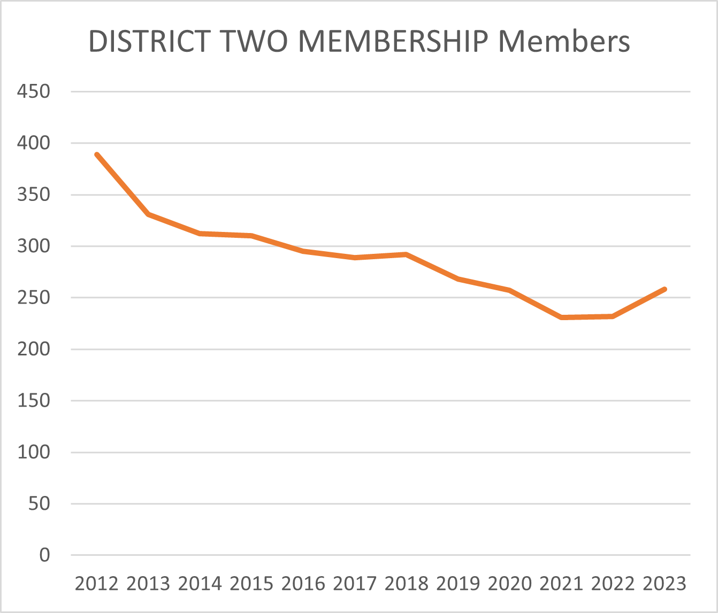
Membership has dropped from 389 in 2012, to a record low of 231 in 2021, up to a current membership of 257. Number of clubs dropped from 18 to 14, now 15. (Good news – we’re rebounding!)

Slide 5
“Yes, but the Board…”
The Board has been doing everything it can to keep the District solvent, including Zoom visits, and has been making sacrifices while still managing the business of the District. Reimbursement for many eligible costs have not been requested by individual board members, preferring to donate in kind.
Historically the Board has had Conference registration, room and board, and travel paid. In recent years some board members have chosen not to submit claims for reimbursement.
The Board voted to change the Policies and Procedures to require payment of $100 toward Conference registration by Board members.
The Board also voted to cut overall mileage reimbursement in half.
However, we don’t want anyone to decide not to run for a Board position because they believe they can’t afford it.

Slide 6
ALTRUSANS DONATE:
Their TIME
Their TALENT
Their TREASURE

Slide 7
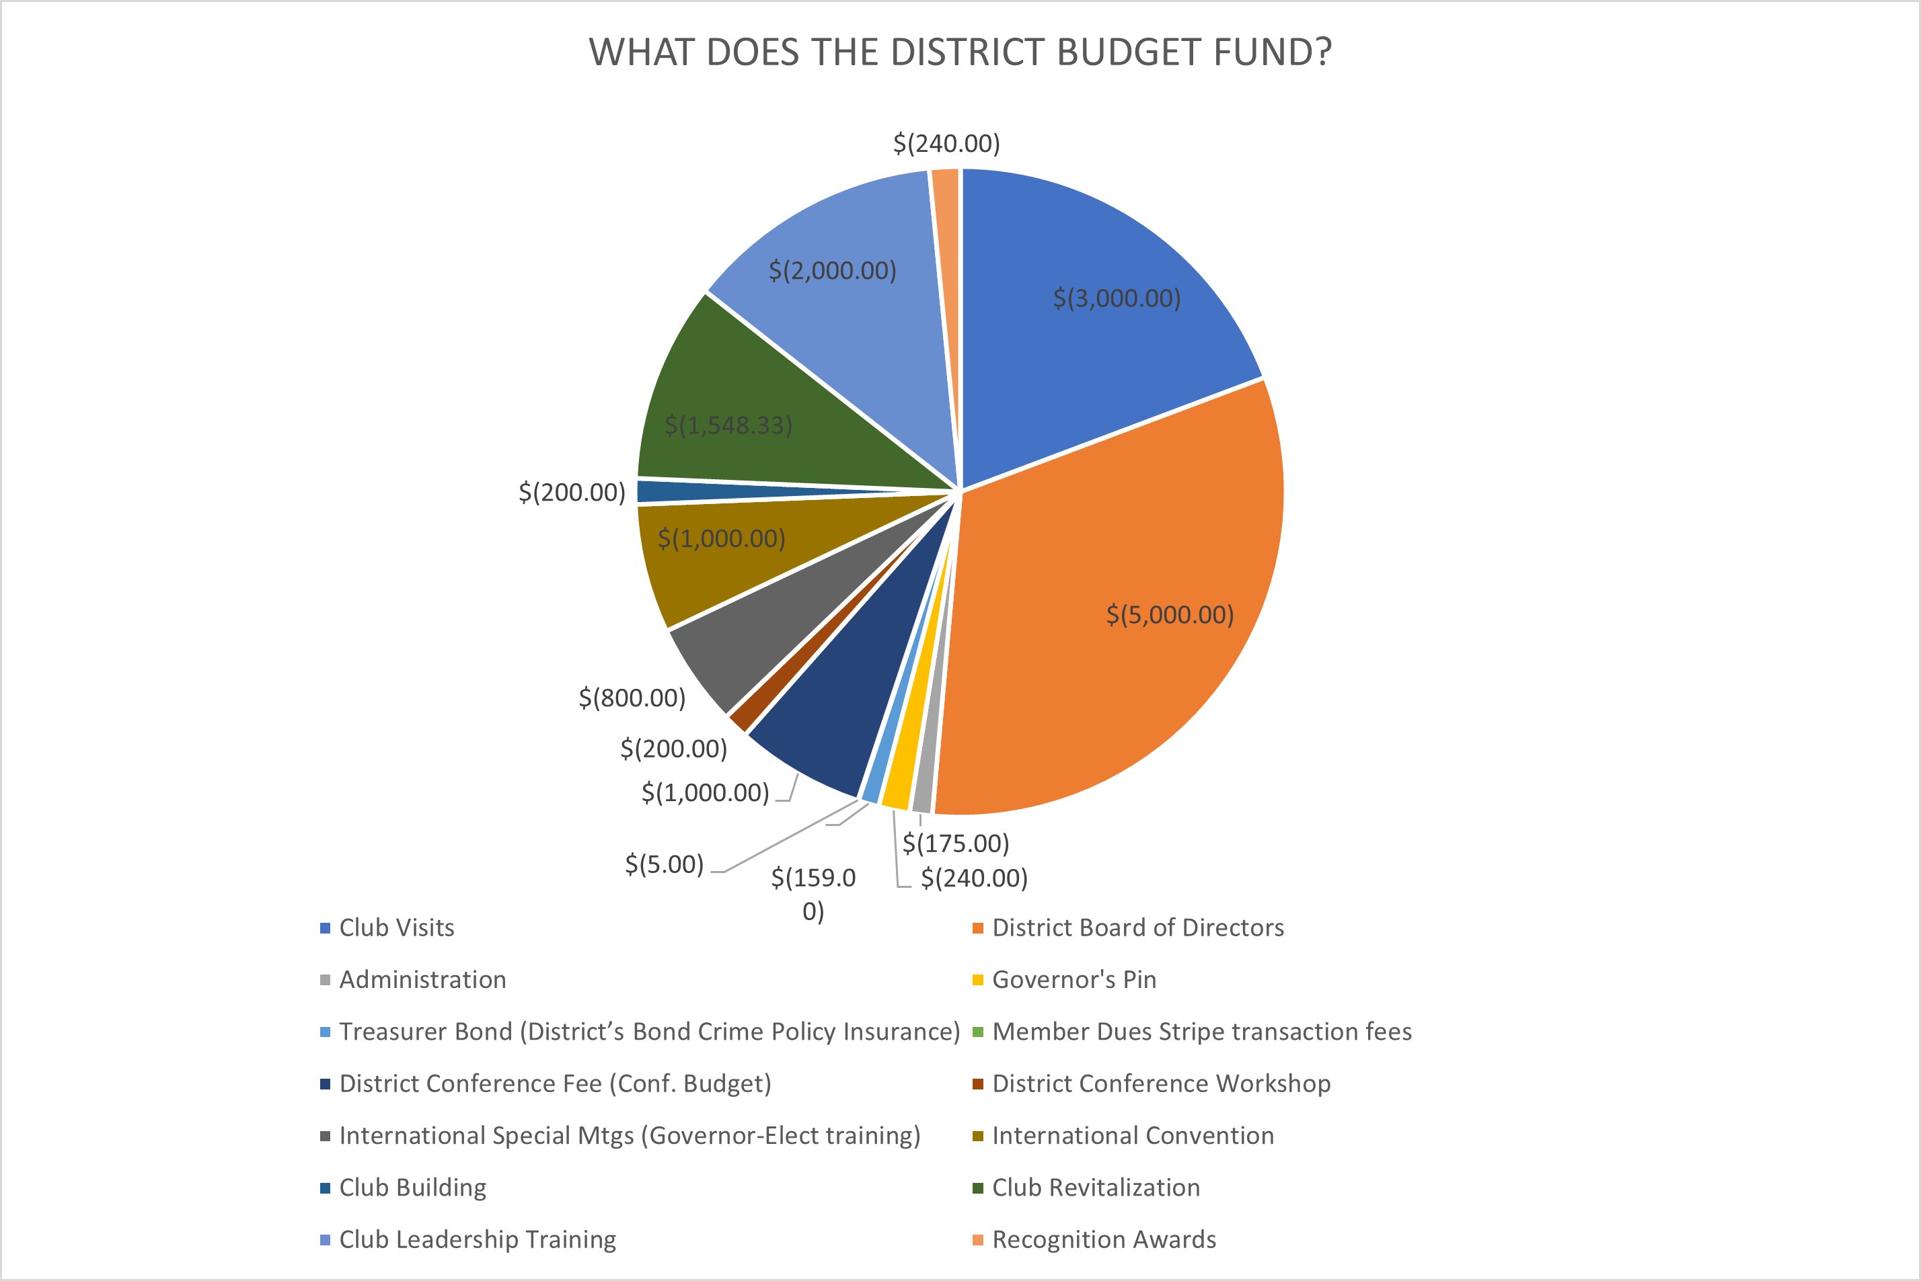
SUPPORT TO CLUBS 46%
DISTRICT OPERATIONS 54%

Slide 8
Raising Dues – how will this help?
Dues by the numbers

Slide 9
Changes in the last year
There have been a number of changes made in the last 12 months. Some increased revenue, others increased or decreased expenditures.
Bond raised to $25,000: - $79
Raised Conference Fees: + $75
Cut mileage reimb: + ??? (cut in half)
Dues increased by $10: + $2580
Another change has helped support the Conference budget specifically (to help lower registration cost for all members)
Board members paying $100 reg: + $1000

Slide 10
BOTTOM LINE
The District’s Proposed Budgets for the last few years have required showing a possible expenditure of unreserved funds (checking account balance) in order to present a balanced budget, which is not sustainable
Increased costs and decreased membership have contributed to the problem
We can and will continue to increase membership, but cost of living is not likely to decrease significantly and will probably increase
It is our belief that Altrusa membership is still a great value, and the Board truly appreciates our Altrusans and their flexibility.

Slide 11
Thank you
Questions?

